Slide 1
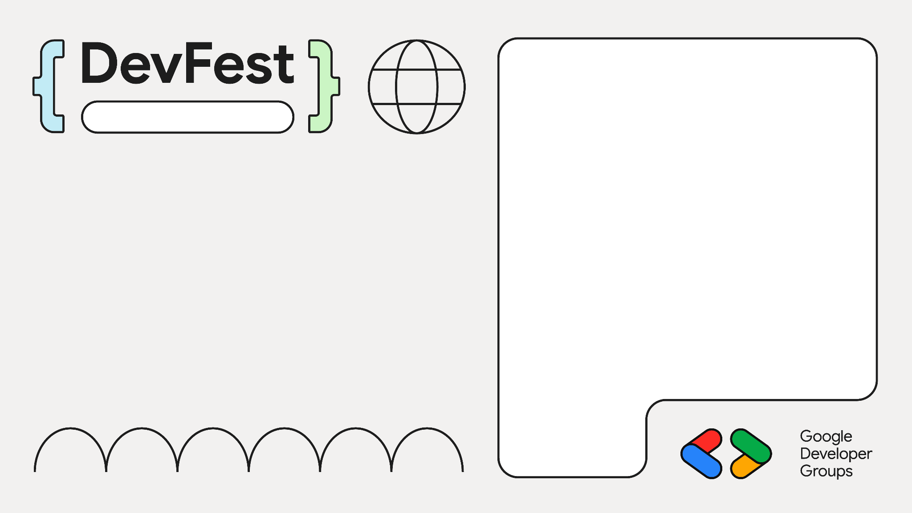

Vision Language Models & PaliGemma
Lucknow 2024
Nitin Tiwari
Google Developer Expert - Machine Learning Associate Data Scientist @ Colgate India

Slide 2





$whoami
Associate Data Scientist @ Colgate-Palmolive (India) Ltd.
Google Developer Expert - AI/ML
Contributor to Google Dev Library, Gemma Cookbook
Technical speaker; talks across Asia, Europe
Love writing blogs on AI/ML

Slide 3
Content
Introduction to Vision Language Models
Architecture of VLMs
PaliGemma and some examples
Imagen3 and Veo
Resources

Slide 4
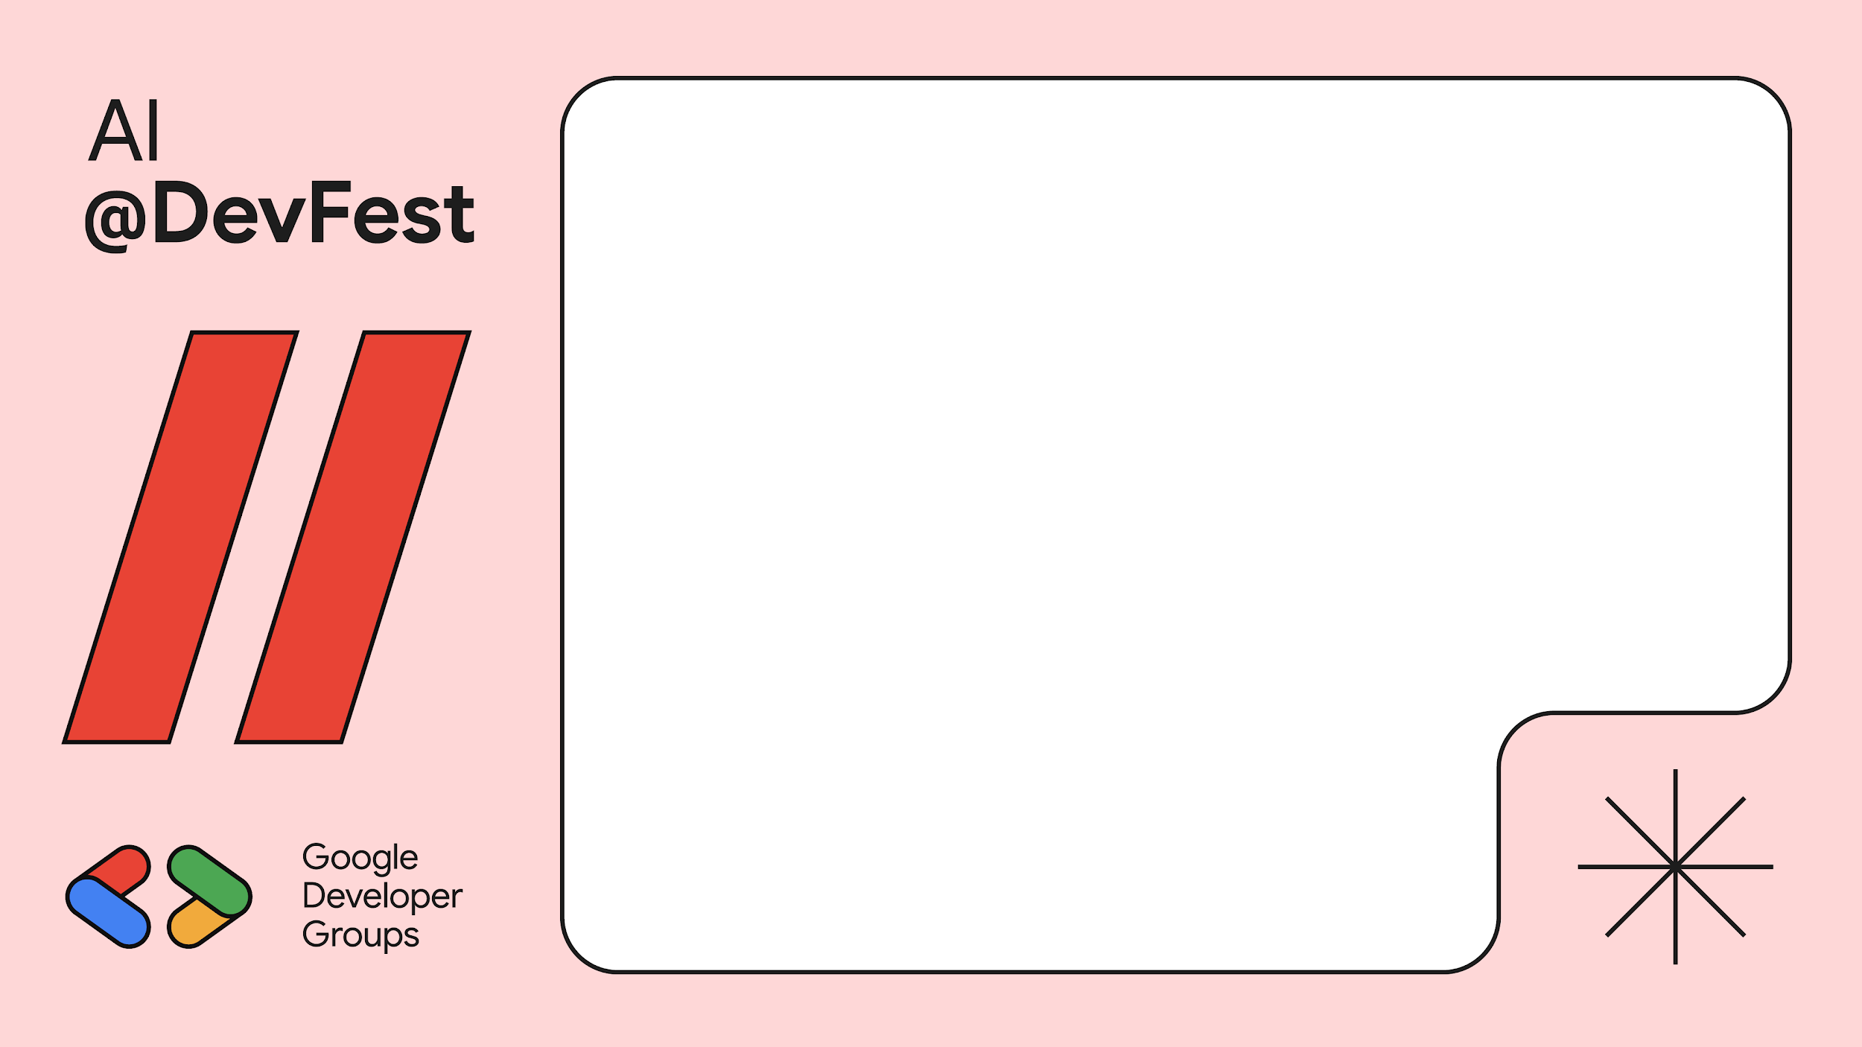
Vision Language Models

Slide 5
What are Vision Language Models?
Vision Language Models are multimodal models that learn from images and text, generating text outputs from image-text input pairs.
They excel in zero-shot capabilities and can perform tasks like image recognition, visual question answering, document understanding, and more.
These models can also capture spatial properties and output bounding boxes or segmentation masks for specific objects.

Slide 6
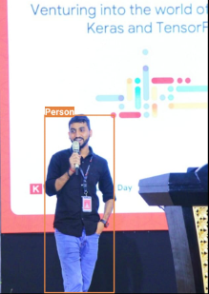
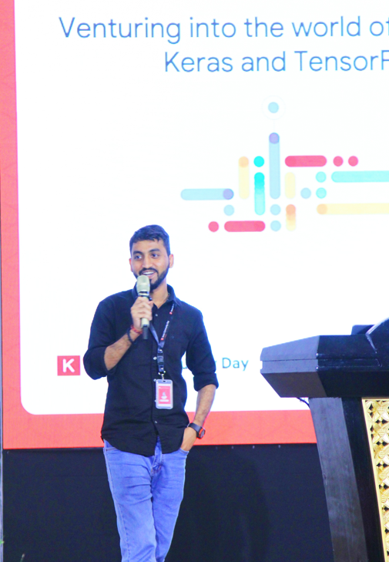
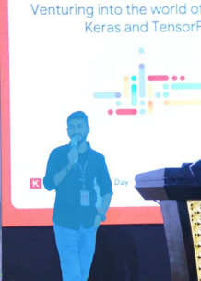
Vision Language Models
Zero-shot Object Detection
Detect Objects
Zero-shot Segmentation
Segment
Vision Language Model
Visual QA
What text is present in this image?
Venturing into the world of Keras and TensorFlow

Slide 7
Architecture of VLMs

Slide 8

Architecture of a typical VLM
Text Output
Text Decoder
Text Decoder
Projected visual tokens + text embedded tokens
Multimodal Projector
Text Prompt
Multimodal Projector
Text Prompt
Image Encoder
{CLIP, SigLIP etc.}
Frozen (not trainable)
Not frozen

Slide 9

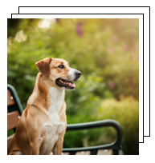
Contrastive Language-Image Pretraining (CLIP)
Text Encoder
…
A dog sitting on a bench
T₁
T₂
T₃
…
T_{N}
Input Texts
I₁
I₁T₁
I₁T₂
I₁T₃
…
I₁T_{N}
I₂
I₁T₁
I₁T₂
I₁T₃
…
I₁T_{N}
Image Encoder
I₃
I₁T₁
I₁T₂
I₁T₃
…
I₁T_{N}
.
.
…
I₁T₁
I₁T₂
I₁T₃
…
I₁T_{N}
.
I₅
I₁T₁
I₁T₂
I₁T₃
…
I₁T_{N}
Input Images

Slide 10
PaliGemma

Slide 11

PaliGemma
PaliGemma is an open Vision Language Model from Google with just 3B parameters designed to perform a variety of tasks such as image captioning, object detection, image segmentation, visual question & answering, optical character recognition, and more.
Inspired by PaLI-3, PaliGemma uses SigLIP (Sigmoid Loss for Language Image Pre-Training) as the image decoder and Gemma 2B as the underlying language model.
I’ll handle the vision capabilities
I’ll handle the textual part
SigLIP (image encoder)
+
Gemma 2B (text decoder)
=

Slide 12
PaliGemma
PaliGemma is available in different variants:
Pre-trained model: The general purpose base model trained for a variety of tasks.
Fine-tuned model: Customized for doing specific tasks.
Mixed model: A mixture of PT and FT PaliGemma models.
PaliGemma comes in 3 resolutions: 224 x 224, 448 x 448 and 896 x 896.
But… why do we need a fine-tuned model? 🤔

Slide 13
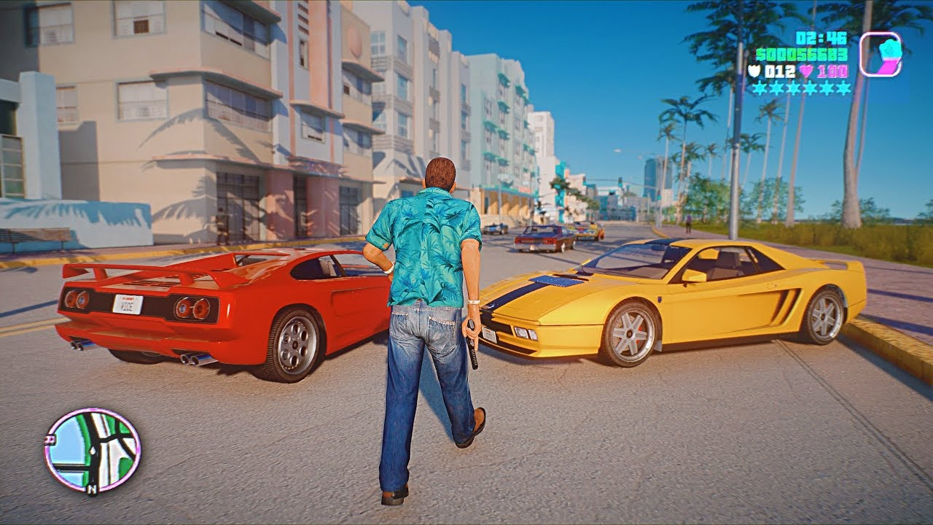
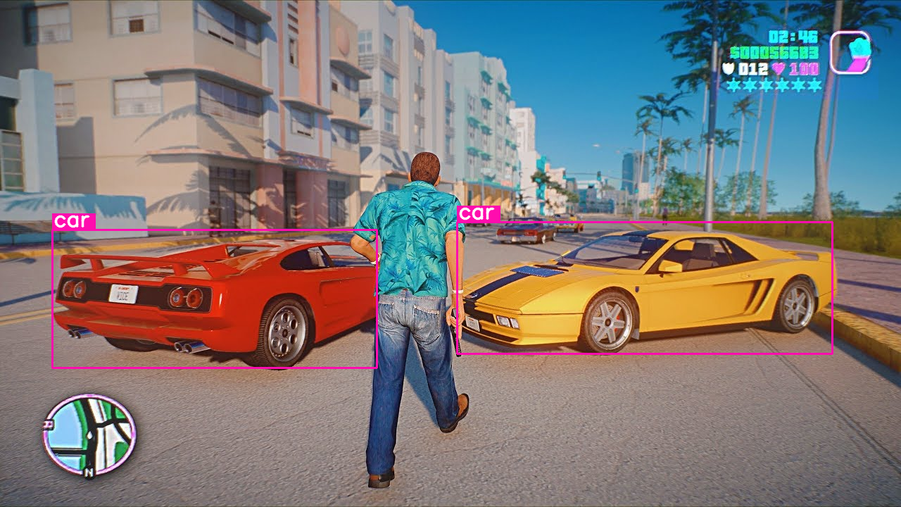

When do we need to fine-tune?
Prompt: Detect car
Output
Pre-trained models are best suited for general purpose tasks. As long as the pre-trained model works well, there’s no need to fine-tune it.

Slide 14


When do we need to fine-tune?
Prompt: Detect red car
Output
The pre-trained model has failed to detect all red cars specifically. So, we need to fine-tune it so that it can detect all the red cars.

Slide 15
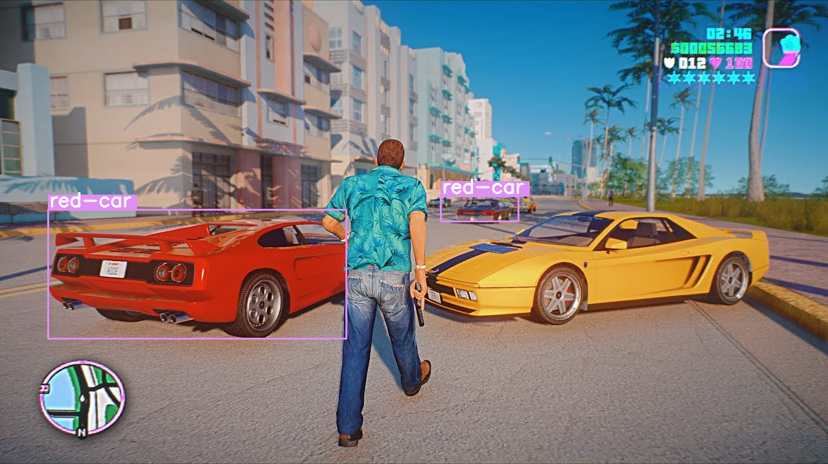
How does fine-tuning help?
Before fine-tuning
After fine-tuning
After fine-tuning, the results have greatly improved.

Slide 16
Examples built with PaliGemma * All the images/videos used are real, and tested without editing

Slide 17
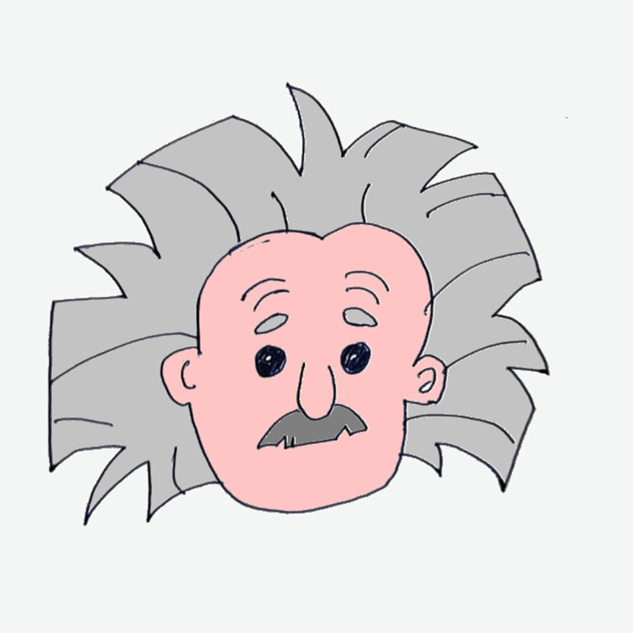
Visual Question & Answering
Given an image, PaliGemma can answer questions based on it.
Prompt: Describe this image.
Response: This is a cartoon picture of Einstein.

Slide 18
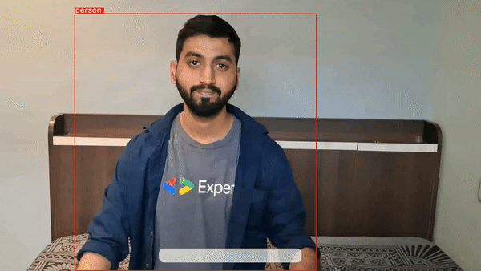
Zero-shot Object Detection
PaliGemma is capable of zero-shot object detection, meaning, without training the model on specific datasets, it can detect objects with just a text prompt.

Slide 19
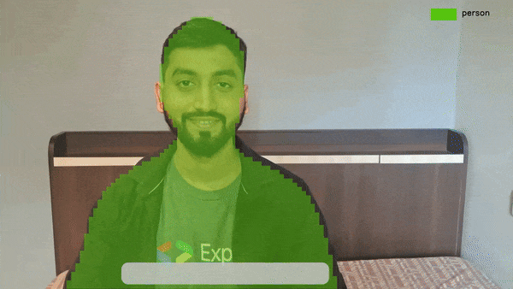
Semantic Segmentation
PaliGemma can also segment objects in images and videos.

Slide 20
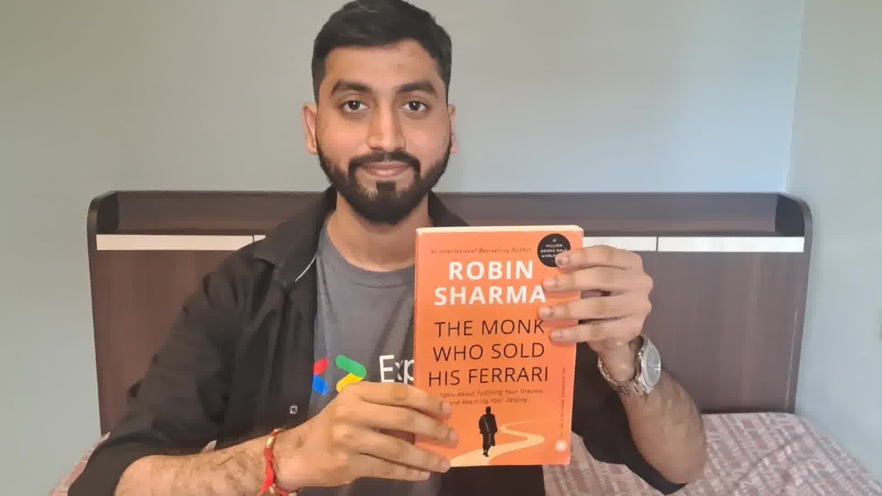
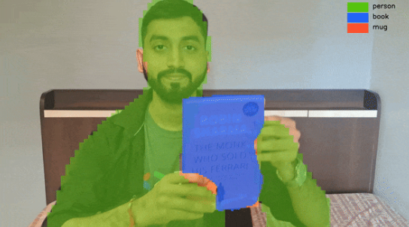
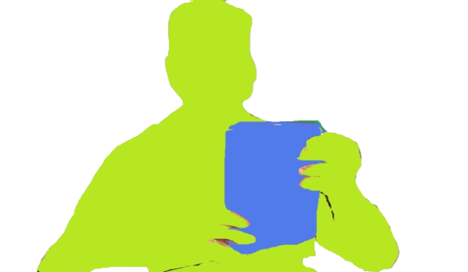

How does it work?
Text prompt: Segment person, mug, book
<loc10><loc250><loc320><loc400><seg058><seg071> … person
Parse the output from PaliGemma model and draw segmentation mask on the input image.
<loc50><loc80><loc120><loc400><seg064><seg082> … book

Slide 21
<PaliGemma>
Editable Location

Slide 22
Import libraries
from transformers import AutoTokenizer, PaliGemmaForConditionalGeneration, PaliGemmaProcessor
import torch
Load pre-trained PaliGemma model
device = torch.device("cuda" if torch.cuda.is_available() else "cpu")
model_id = "google/paligemma-3b-mix-448"
model = PaliGemmaForConditionalGeneration.from_pretrained(model_id, torch_dtype=torch.bfloat16) processor = PaliGemmaProcessor.from_pretrained(model_id)
Give input image and text prompt
input_image = Image.open(‘image.jpg’)
prompt = ‘’detect person’’

Slide 23
Pass the input to PaliGemma
inputs = processor(text=input_text, images=input_image, padding="longest", do_convert_rgb=True, return_tensors="pt").to("cuda")
model.to(device)
inputs = inputs.to(dtype=model.dtype)
Get output
with torch.no_grad():
output = model.generate(**inputs, max_length=496)
paligemma_response = processor.decode(output[0], skip_special_tokens=True)[len(input_text):].lstrip("\n") print(paligemma_response)
Pass input image and text prompt
# Parse the PaliGemma model response as per need.
def parse_response(paligemma_response):
…..

Slide 24
Imagen3 & Veo

Slide 25
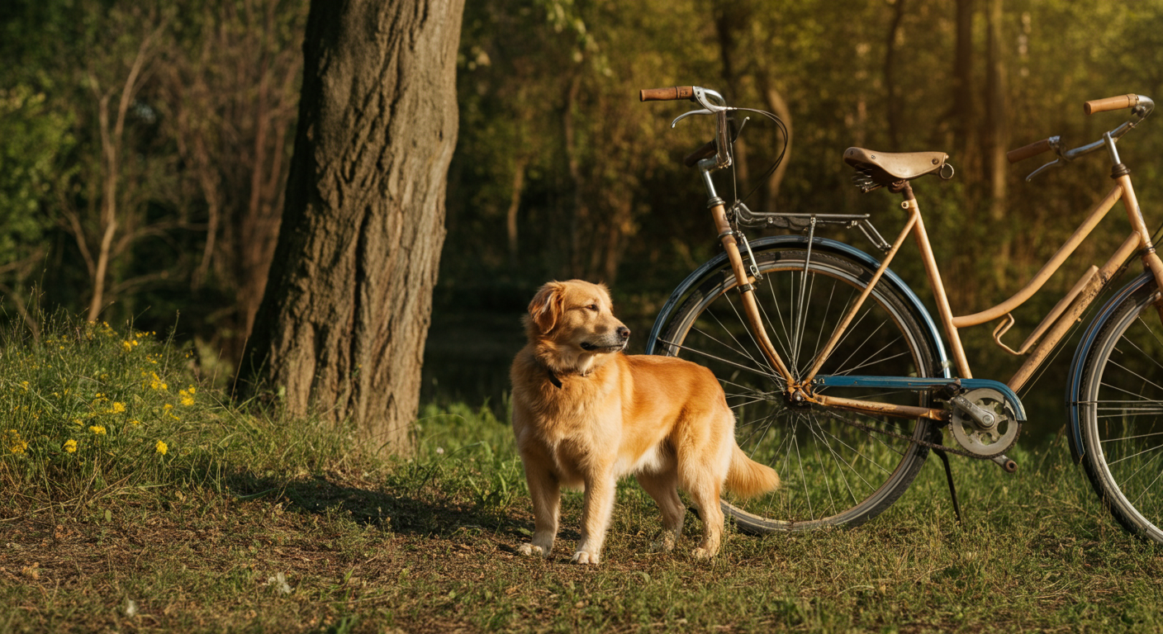
Imagen 3
The most capable text-to-image model that can generate high quality, photorealistic images with an incredible level of detailing.
Imagen 3 is available on Vertex AI in a limited preview; to be out soon for all in India.

Slide 26
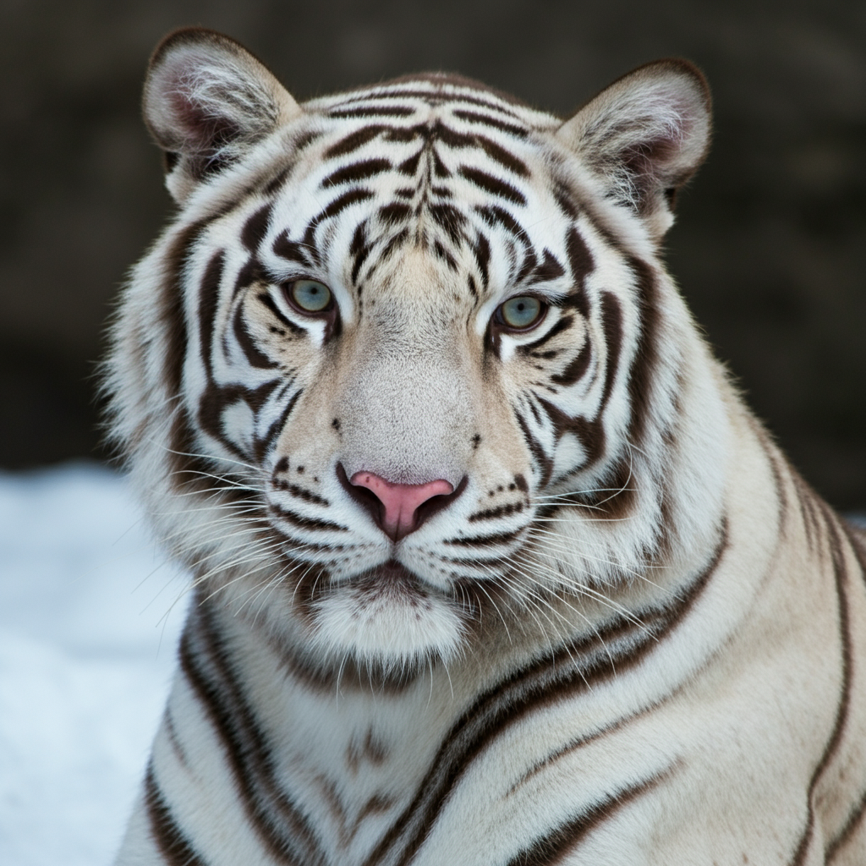
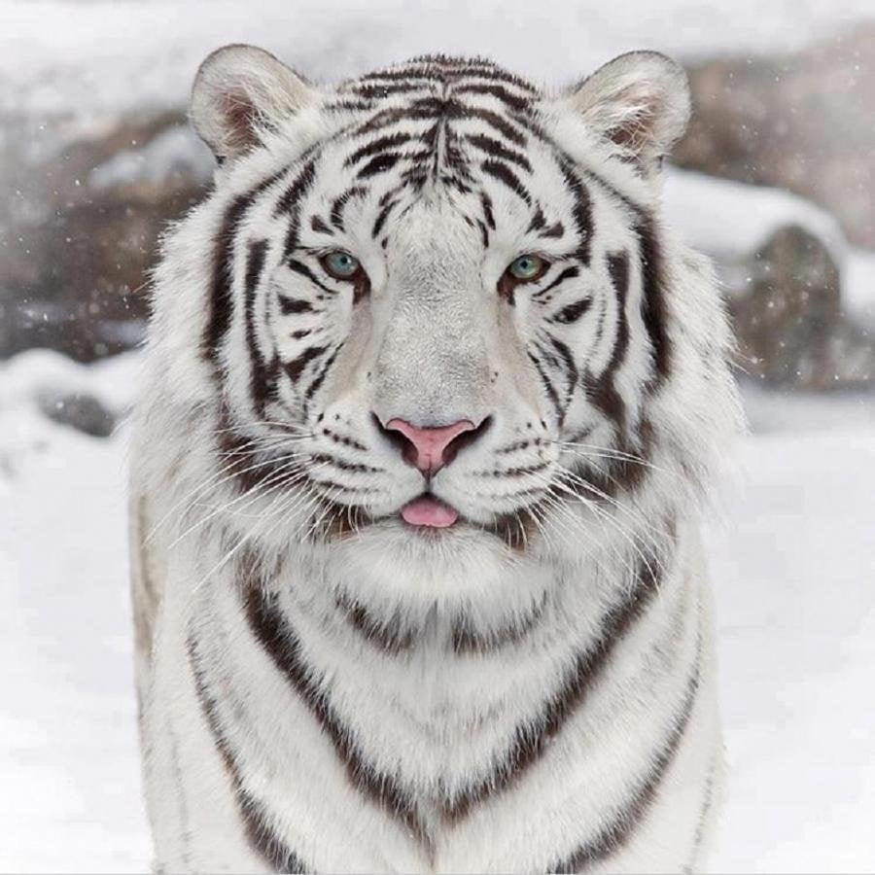
Activity
Which image is real?
Generated by Imagen 3
Real
Image (right) source: Google Images

Slide 27

Imagen 3
Prompt: A photorealistic image of an old Indian lady wearing saree, smiling, white shiny teeth, blur background

Slide 28
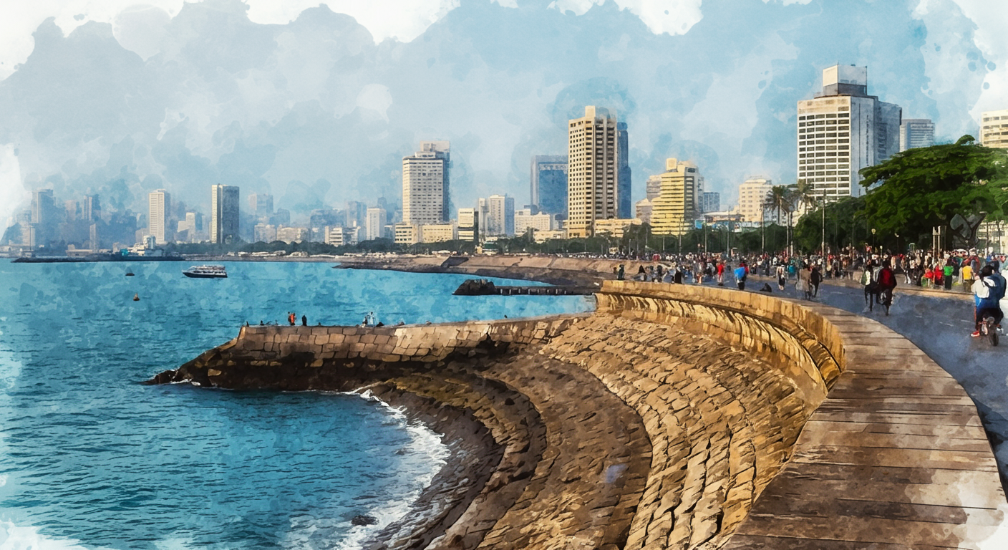
Imagen 3
Prompt: A watercolor painting of Marine Drive, Mumbai.

Slide 29
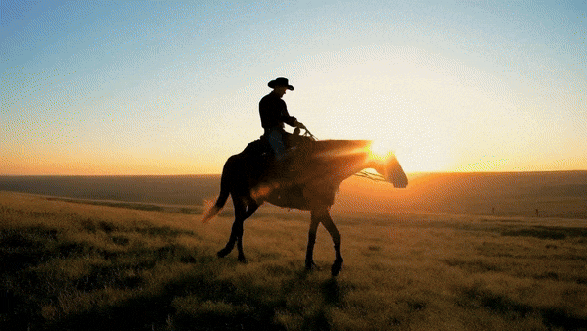
Veo
The most capable video generation model that can generate high quality HD (1080p) videos up to 1 minute in different cinematic and visual styles and shots.
Veo is available in VideoFX as a limited preview.
Source: Google DeepMind

Slide 30
Resources

Slide 31
Resources
Vision Language Models: https://huggingface.co/blog/vlms
Gemma official documentation: https://ai.google.dev/gemma/
PaliGemma: https://ai.google.dev/gemma/docs/paligemma
Gemma Cookbook: https://github.com/google-gemini/gemma-cookbook
Get started here: https://github.com/NSTiwari/PaliGemma

Slide 32

Lucknow 2024
Thank you.
linkedin.com/in/tiwari-nitin
medium.com/@tiwarinitin1999
x.com/@NSTiwari21
github.com/NSTiwari

